Slide 1
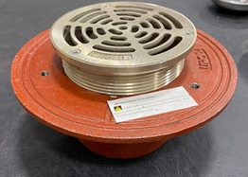
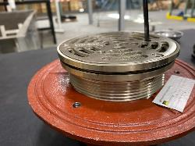
RTS5-1 Installation Instruction
How to change from 5-1 solid drain to adjustable Top Set by using the Retrofit Top Set Kit
Current Solid 5-1
Height adjustable TS5-1

Slide 2
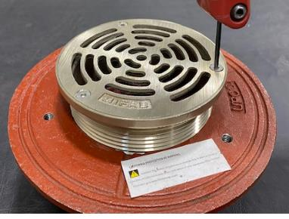
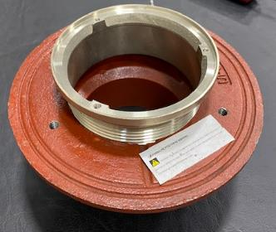
Step 1
Remove the 5-1 strainer (keep the screws.)

Slide 3
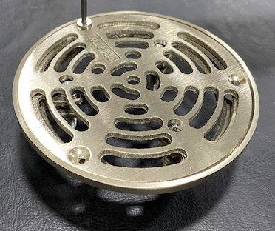
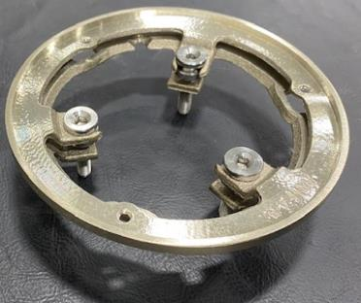
Step 2
Remove the strainer of RTS5-1 (keep the screws.)

Slide 4
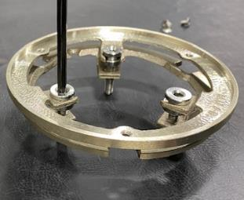
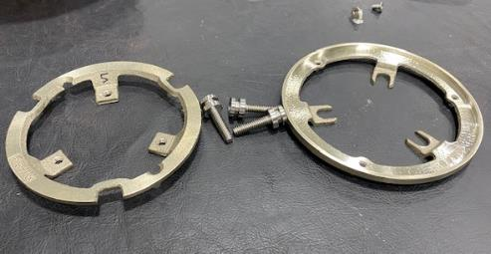
Step 3
Separate the Shank Ring from the Collar of RTS5-1.
Alternatively unscrew the three set screws, few turns at time.
Collar
Shank Ring

Slide 5
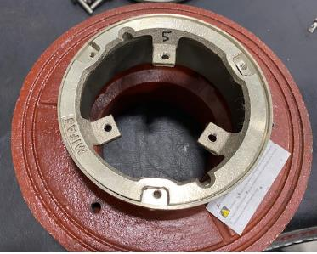
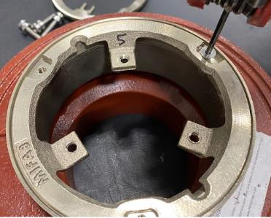
Step 4
Assemble RTS5-1 shank ring on 5-1 Shank.
Align the 3 shank ring notches to the 3 tapped holes of 5-1 shank; secure shank ring in place with the 3 short set screws saved from 5-1.

Slide 6
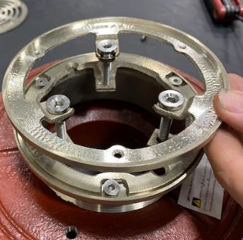
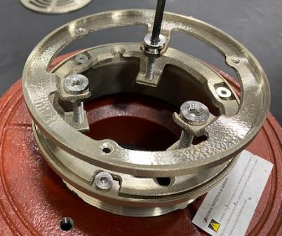
Step 5
Attached the RTS5-1 collar to shank ring
Align the 3 large set screws to destinated shank ring tapped holes
Alternatively tighten the set screws, few turns at a time.

Slide 7
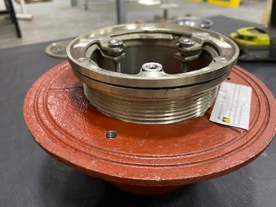
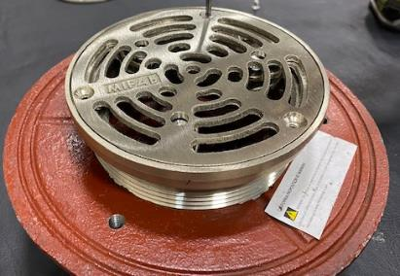
Step 6
Attached the RTS5-1 strainer to shank ring
Align the 3 peripheric chamfered holes with the peripheric small tapped screws of the shank ring.
Secure the strainer in place by using the 3 small set screws.

Slide 8
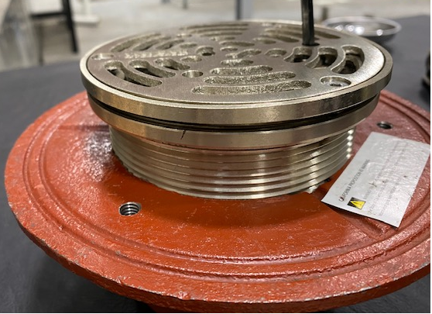
Step 7
Adjust the top set to desired height, by using the 3 large top set screws

