Slide 1
Mifab HydroMax™ Siphonic Drainage
Mifab
Mifab
Leaders in Siphonic Drainage

Slide 2
Mifab HydroMax®
Presentation
Presentation by Michael Whiteside, President, Mifab Inc.
Notes:
So what is Siphonic Roof Drainage?
Siphonic Drainage is an innovative solution which utilises the power of water accelerating as it falls down the vertical downpipe to generate a naturally induced siphon which in turn creates a high-performance roof drainage solution .

Slide 3
Mifab HydroMax® Topics
Benefits General
Benefits to Client
Mifab HydroMax® drains and HydroTechnic™
Key Advantages
HydroMax web-site
Prototype file structure
Notes:
So what is Siphonic Roof Drainage?
Siphonic Drainage is an innovative solution which utilises the power of water accelerating as it falls down the vertical downpipe to generate a naturally induced siphon which in turn creates a high-performance roof drainage solution .

Slide 4
What is Mifab HydroMax™ Siphonic Roof Drainage?
Mifab HydroMax™ is an innovative solution which utilises the power of a natural siphon to create a high-performance roof drainage solution.
Notes:
So what is Siphonic Roof Drainage?
Siphonic Drainage is an innovative solution which utilises the power of water accelerating as it falls down the vertical downpipe to generate a naturally induced siphon which in turn creates a high-performance roof drainage solution .

Slide 5
Why use Mifab HydroMax™ Siphonic Roof Drainage?
Mifab HydroMax™ is an Engineered Solution which provides many Technical Benefits
Mifab HydroMax™ offers cost savings ranging from
25% to 45%!
Notes:
Why would you use a Siphonic Roof Drainage solution?
Siphonic Drainage is an Engineered Solution which provides many technical benefits which we will provide examples of during this presentation
It is also one of these rare products that in addition to technical benefits can also offer cost savings
In suitable project types these savings normally range from 25% to 45%!

Slide 6
Siphonic Drainage – Brief History
Concept invented in Finland by Olavi Ebling in late 1960’s
First major installation in Sweden in 1972.
Unregulated Industry Grew through 1980’s
UK Government Commissioned Research during the 1990’s by Hydraulic Research Wallingford (Refer HR Wallingford reports SR 463 & SR 473)
2000 – Introduction of European Standards
2005 - ASME A112.6.9:2005 Published for Siphonic Roof Drains
2007 American and British standards published. These are comprehensive design, hydraulic requirements, pipe material and products standards for siphonic drainage.
Our approach is to Educate and explain how HydroMax works in accordance with the current principal Standards
Notes:
Siphonic drainage started off as a Concept invented in Finland by Olavi Ebling in late 1960’s
First major installation in Sweden in 1972.
An Unregulated Industry Grew through 1980’s which led to specifiers becoming uncertain as to how siphonic should be specified and utilised.
This led to UK Government Commissioned Research by HR Wallingford during the 1990’s (the HR stands for Hydraulic Research)
HR Wallingford reports SR 463 & SR 473 were studies on performance of siphonic systems on flat roofs and in gutters that you can refer to but technical advances and the advent of BS 8490 makes them a little superfluous.
European Standard BS EN 12056-3 introduced in 2000 which was the first standard to include a section for Siphonic drains.
BS 8490 was first published in March 2007 – this is Comprehensive Siphonic Drainage Standard covering all aspects of design rainfall rate selection, design, hydraulic parameters to be met, pipe specifications, testing and maintenance.

Slide 7
Top 10 Technical Benefits
Mifab HydroMax® Siphonic Roof Drainage
Smaller Diameter pipe work – approx. half the gravity dia.
Horizontal pipes are installed without GRADE – Flat Level.
3. Pipes run full-bore with self-scouring properties.
4. A significant Reduction in Below Grade Drainage (common range is from 20% to 60%).

Slide 8
Top 10 Technical Benefits (continued)
5. Rainwater down pipes routed to the Engineer’s Preferred Locations - This frees up valuable building space.
6. Routing of rainwater down pipes to the perimeter of buildings Eliminates Below Grade Drainage Under the Building Floor.
7. Easy co-ordination of services due to pipe work running flat.

Slide 9
Top 10 Technical Benefits (continued)
8. Fewer pipes = Reduced construction time and cost.
9. Ability to route rainwater pipes to pond retention or Rainwater Harvesting.
10. Less Ponding on the roof due to efficient water flow

Slide 10
Potential Benefits
Fewer Downpipes
Free up space in store / stock room
Located in convenient locations
No break in racking to accommodate downpipes
2. Remove internal downpipes – no drainage under building
3. Potentially fewer roof drains due to high efficiency
4. We would look to work with prototype design to minimise civils below grade drainage – this is a big opportunity to save you construction time and cost.
5. Less Ponding on the roof due to efficient water flow

Slide 11
What is wrong with Traditional Gravity Drainage Systems?
Traditional Gravity drainage systems work but they are inefficient and have a number of factors restricting performance.
Notes:
Before explaining siphonic drainage lets explore What is wrong with Traditional Gravity Drainage Systems?
Traditional Gravity drainage systems work - as they have done for centuries
However, they are inefficient with a number of factors restricting their performance.

Slide 12
Restrictive Factors of Gravity Drainage
The water flow-rate is dictated by the gradient available (this gradient also restricts the distance a pipe can travel).
Multiple rainwater pipes in locations largely dictated by the gravity hydraulics rather than design team choice.
Gravity drains require ⅔ air to transport ⅓ water.
Vortex formation within vertical gravity pipes results in the water being transported in an inefficient spiral motion rather than straight through the pipe.
The driving force is only the depth of ponding or ‘head’ of water above the roof drain (normally mush deeper than most people expect).
Notes:
1. The slope to which the pipework is installed at dictates how much water the pipe can transport. The greater the gradient the higher the flow. But the slope also limits how far the pipe can travel before it encroaches through the ceiling or roof space.
2. Because the slope limits how far the pipes can travel, the result is that you have many Rainwater downpipes sited in locations which have been dictated by the hydraulics rather than design team or client’s choice.
3. Gravity drains require ⅔ air to transport ⅓ water resulting in large diameter pipes.
4. The vortex that you would see at a bath or sink plughole happens at all gravity drains. The flow is an inefficient spiral motion rather than straight flow into the pipes below the drain.
5. The only driving force for the system is the depth of water on the roof forcing water into the roof drain. The deeper the water the greater flow into the pipe below.
As a rule of thumb, given equal inflows, a siphonic drain will have approximately half the ponding of a gravity drain.

Slide 13
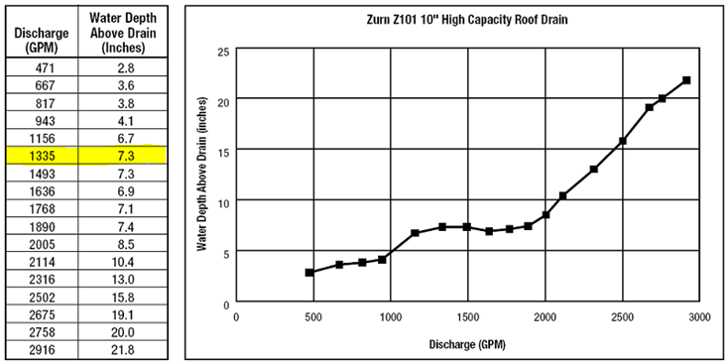
“High Performance” Gravity Drain (taken from Manufacturers web-site)
Gravity 10” Drain – Depth = 7.0” to Discharge 1200 GPM

Slide 14
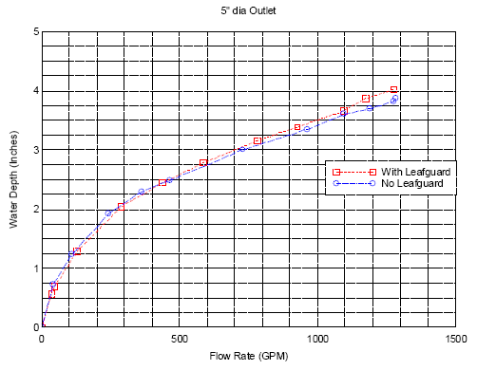
Mifab HydroMax 5” Siphonic Drain
Equivalent Flow (1200GPM)
Half the Diameter
Half the ponding depth of the Gravity drain
5” Drain – Depth = 3.6” to Discharge 1200GPM

Slide 15
Gravity Drain to Mifab HydroMax Drain Comparison
Weight of Water on the Roof in pounds
38,660 sq. ft. Roof Area
7” Ponding - 22,552 cu. ft. – 1,407,900 lbs. (GRAVITY)
Only 3.6” Ponding - 11,598 cu. ft. – 724,063 lbs. (Mifab HydroMax)
683,837 lbs. SAVED using Mifab HydroMax

Slide 16
Vertical Gravity pipes run ‘full’ at only 1/3 water
⅓ water in annular flow
⅔ air core
Notes:
Vertical Gravity pipes run ‘full’ at only 1/3 water
With the 1/3 water in annular flow where the water adheres to the inner pipe wall with an air core down the middle.

Slide 17
Principles of Mifab HydroMax™ Siphonic Drainage
The Siphonic Roof Drain eliminates air entering the pipe promoting water filled pipework
The full bore of the pipework carries the rainwater
Water, without air, accelerates down the vertical downpipe, creating negative pressure and naturally generating a high performance siphonic flow
The full height of the building provides the energy for this highly efficient Rainwater Drainage Solution
Notes:
The main principles of siphonic drainage are
First of all the siphonic roof drain is design to prevent vortex formation and also prevent air entering the piping system.
This allows the full bore of the pipes to carry the rainwater.
As water without air accelerates down the vertical downpipe, it creates negative pressure and naturally generates a high performance siphonic flow
Unlike gravity systems we now use the full height of the building to provide the energy for this highly efficient Rainwater Drainage Solution

Slide 18
Fully Primed Mifab HydroMax System
Negative Pressure
Roof or Gutter
Mifab HydroMax Roof Drain
Tail-pipes
Horizontal Carrier Pipe
Downpipe
The full height of the building provides the energy for this highly efficient Rainwater Drainage Solution
Discharge
Notes:
Now in its fully primed state, the negative pressure in the system has increased as we are utilising the full height of the building to draw water off the roof.

Slide 19
System Comparison
Traditional
Gravity
Mifab HydroMax
Siphonic
air core
water in annular flow
water
No Air
air core
water
water
Notes:
Looking at the two systems side by side. Going back to the vertical section of a gravity rainwater system, we can begin to see the inefficiency. We have to design the system to account for air flow as it is this flow of air that allows the water to move in the pipe section ( the air is entrained by the movement of water and replaces the volume of water moved).
With a siphonic rainwater system it is working at its most efficient at the point that it is full i.e. 100% full of water with all air eradicated. You can also begin to see another advantage of using a siphonic system in that we can deliver similar flow rates with smaller pipes and fittings

Slide 20
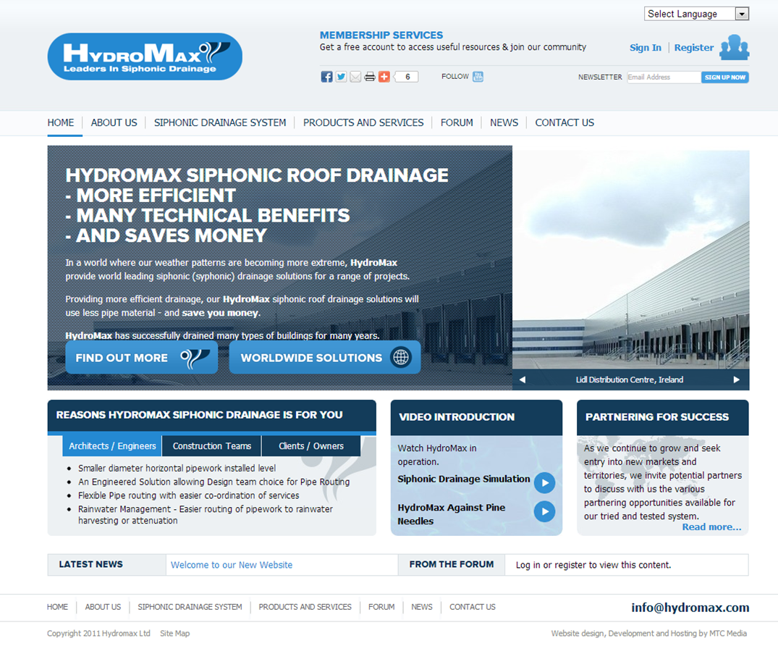
Mifab HydroMax™ Siphonic Roof Drainage Videos (these can be viewed at www.hydromax.com )
Notes:
So what is Siphonic Roof Drainage?
Siphonic Drainage is an innovative solution which utilises the power of water accelerating as it falls down the vertical downpipe to generate a naturally induced siphon which in turn creates a high-performance roof drainage solution .

Slide 21
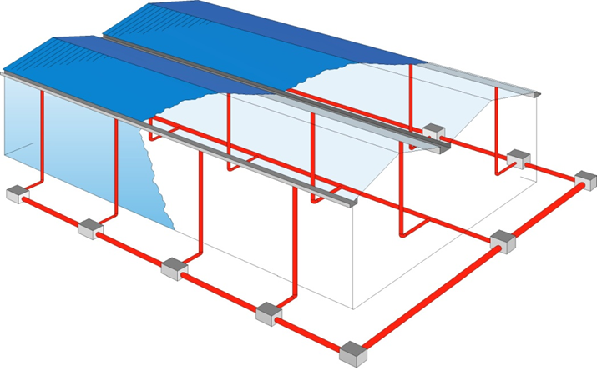
Traditional Gravity Roof Drainage System
Low Performance Roof Drains
Drainage
Under Building Floor
Many Downpipes
Inflexible Positioning
Significant Below Grade Drainage Network (Expensive & time consuming trench work)
Difficult to Route to Pipework to Attenuation/Retention Ponds or Rainwater Harvesting
Notes:
Now, here is the same warehouse that we saw earlier but this time with a Siphonic Roof Drainage system.
You can have fewer roof penetrations because less drains may be used due to the HydroMax siphonic drains having a much higher capacity than gravity drains
The pipes run horizontally to fewer downpipes which results in significantly less below ground drainage
This reduction in underground drainage is where the cost savings come from.
No drainage below the building floor.
There will be significantly fewer Rainwater pipes
Rainwater pipes will be in the locations as chosen by the design team.
Easy routing to rainwater attenuation or harvesting

Slide 22
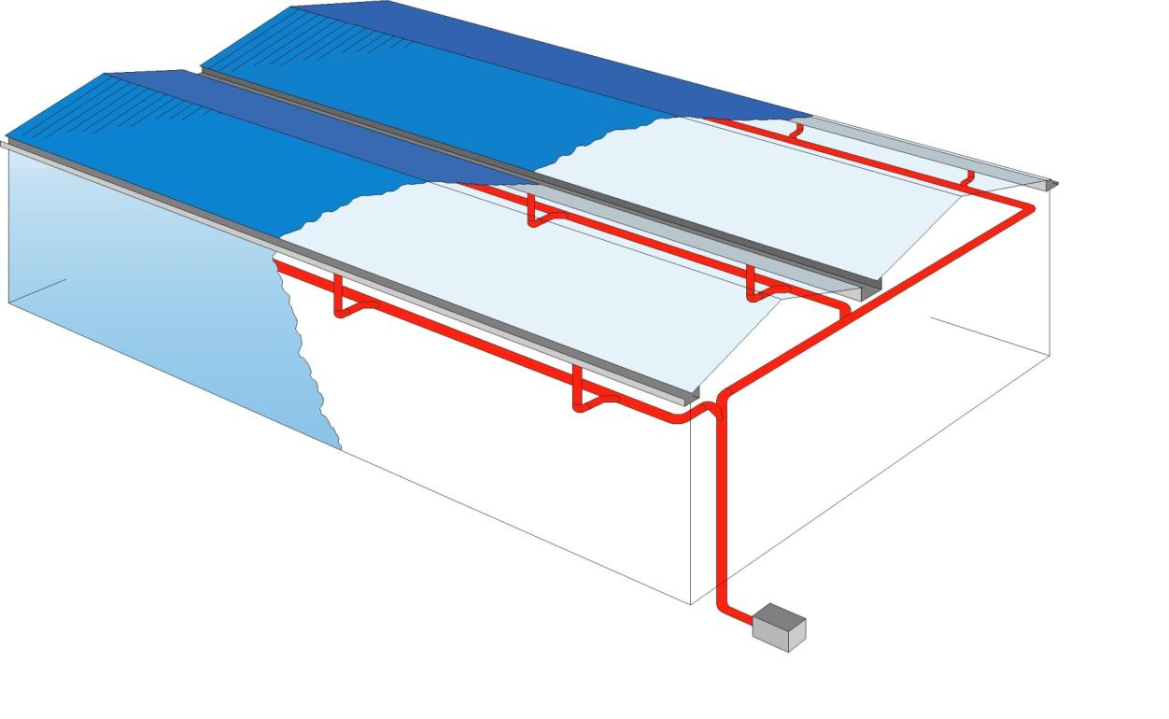
Siphonic Roof Drainage System
High Performance Roof Drains
No Drainage
Under Building
Flexible,
Downpipe
Positioning
Significant Reduction in
Below grade Drainage
Route to Harvesting or Pond Retention
Notes:
Now, here is the same warehouse that we saw earlier but this time with a Siphonic Roof Drainage system.
You can have fewer roof penetrations because less drains may be used due to the HydroMax siphonic drains having a much higher capacity than gravity drains
The pipes run horizontally to fewer downpipes which results in significantly less below ground drainage
This reduction in underground drainage is where the cost savings come from.
No drainage below the building floor.
There will be significantly fewer Rainwater pipes
Rainwater pipes will be in the locations as chosen by the design team.
Easy routing to rainwater attenuation or harvesting

Slide 23
Traditional Gravity System
1600 feet Pipework
Diameters 6” to 18”
330 ft
Mifab HydroMax® Solution
Only 1000 feet Pipe
Diameters 3” to 8”
180 ft
Mifab HYDROMAX®

Slide 24
USA Siphonic Standards
Siphonic Drainage is an Engineered System
Submitted through Chapter One
Roof Drain Product & Performance Standard
ASME/ANSI A112.6.9 Siphonic Roof Drain Standard (published in 2005)
System Design/Installation/Performance Standard
ASPE Technical Standard #45 (published in 2007)
IPC 2012 (Simply seeks compliance with ASPE 45 and ASME A112.6.9)

Slide 25
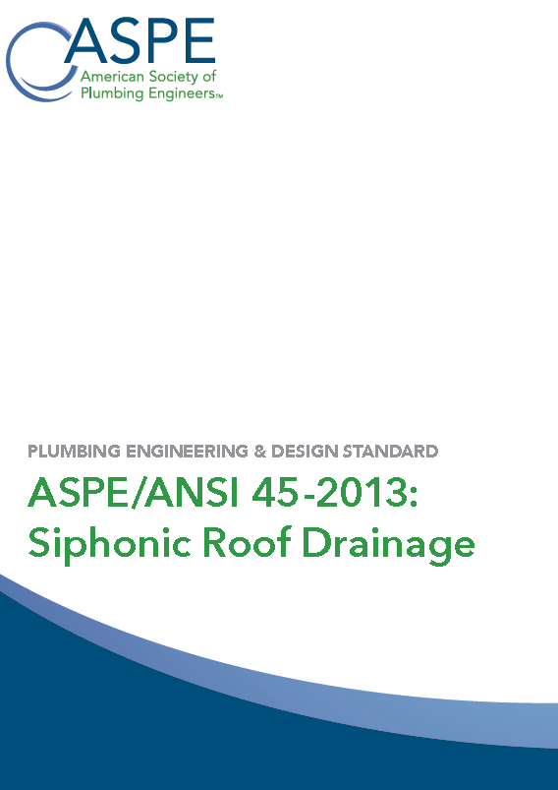
USA Siphonic Standards
ASPE Technical Standard #45
Published in 2007 and reviewed 2012. (with HydroMax’s Bill Ross on committee)
In October 2013, having gained American National Standards Institute approval this revision was published as
ASPE/ANSI 45-2013:Siphonic Roof Drainage

Slide 26
USA Projects
We have numerous projects throughout USA
(over 800 Wal-Mart projects in most or ALL states)
Additionally
HydroMax is a global Brand with Project References
in many countries and many climates

Slide 27
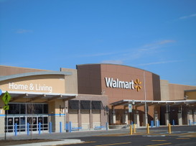
Suitable Projects for Siphonic Drainage
Retail Chains
Notes:
We will now run through a list of suitable project types.
As a rule of thumb we would normally say that you can get technical benefits from a roof area of 1000m2 and cost savings will be achieved at 2500m2 and above
The bigger the roof the bigger the savings.
The first category of project types is Retail chains – siphonic drainage has been extensively used on this type of building since the early 1990’s and is regarded as being the normal roof drainage system for this type of building.

Slide 28
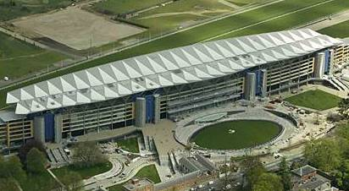
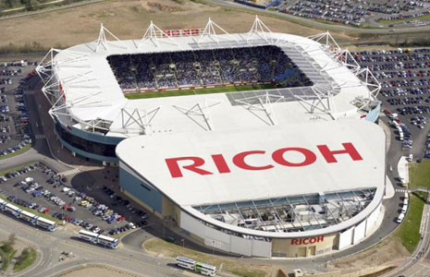
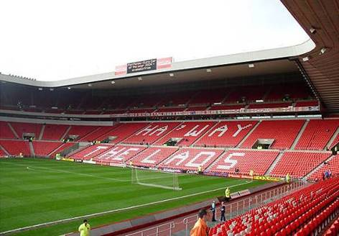
Suitable Projects for Siphonic Drainage
Stadia
Royal Ascot Racecourse
Ricoh Stadium and Arena, Coventry
Stadium of Light, Sunderland
Notes:
Stadium Projects
The Stadium of Light on the left had one quarter of the whole roof area drained to a single drainage point.
The Coventry Stadium and Arena on the right used only 6 rainwater pipes to drain the whole roof.

Slide 29
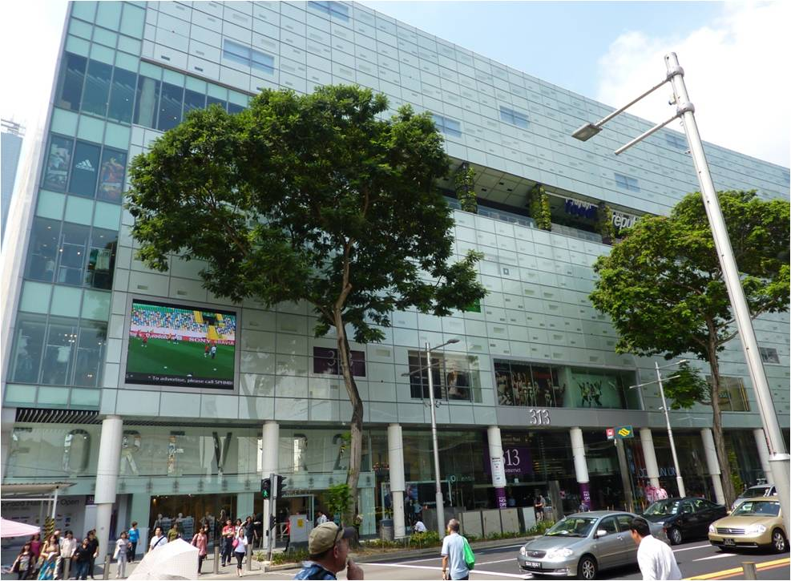
Suitable Projects for Siphonic Drainage
Dundrum Retail Shopping Malls with multi-level Car Parks
313 Orchard Road, Singapore
Notes:
This is a large town centre retail development.
The landlord specified siphonic roof drainage so that all rainwater pipes were routed to landlord areas thus freeing up lettable tenant space to increase the rental earnings.
A Siphonic Roof Drainage system was also used to drain the top level of the multi-storey car park shown on the left third of the site.

Slide 30
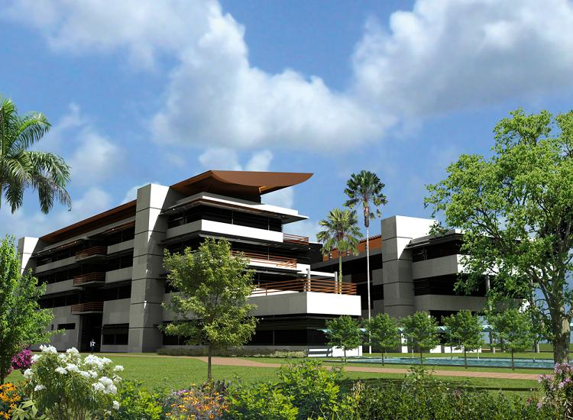
Suitable Projects for Siphonic Drainage
Commercial Office Buildings
Accident Fund, Lansing
E-Tek Flagship Trinidad
Notes:
This is a large town centre retail development.
The landlord specified siphonic roof drainage so that all rainwater pipes were routed to landlord areas thus freeing up lettable tenant space to increase the rental earnings.
A Siphonic Roof Drainage system was also used to drain the top level of the multi-storey car park shown on the left third of the site.

Slide 31
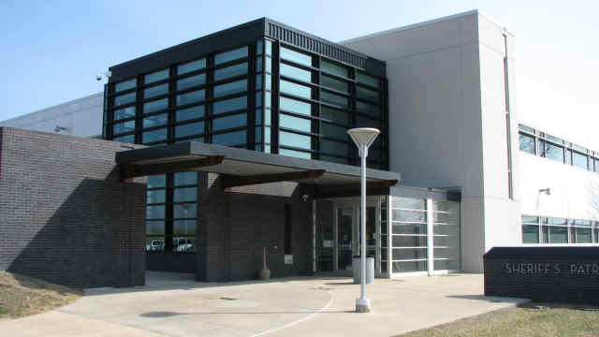
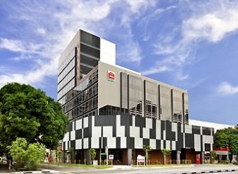
Suitable Projects for Siphonic Drainage
Accommodation/Hotels/Prisons
Student Dorms, Wembley
Johnstone County Detention Center
Ibis Hotel, Singapore
Notes:
This is a large town centre retail development.
The landlord specified siphonic roof drainage so that all rainwater pipes were routed to landlord areas thus freeing up lettable tenant space to increase the rental earnings.
A Siphonic Roof Drainage system was also used to drain the top level of the multi-storey car park shown on the left third of the site.

Slide 32
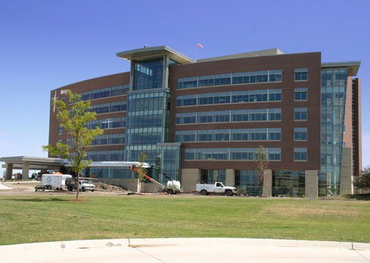
Suitable Projects for Siphonic Drainage
Hospitals
Forest Park Medical Center, Dallas
Mercy Hospital, Des Moines, IA
Notes:
This is a large town centre retail development.
The landlord specified siphonic roof drainage so that all rainwater pipes were routed to landlord areas thus freeing up lettable tenant space to increase the rental earnings.
A Siphonic Roof Drainage system was also used to drain the top level of the multi-storey car park shown on the left third of the site.

Slide 33
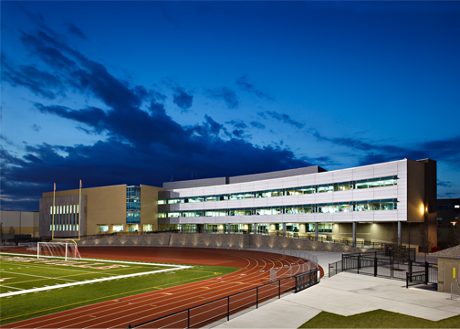
Suitable Projects for Siphonic Drainage
Schools
Naperville High School, IL
Notes:
This is a large town centre retail development.
The landlord specified siphonic roof drainage so that all rainwater pipes were routed to landlord areas thus freeing up lettable tenant space to increase the rental earnings.
A Siphonic Roof Drainage system was also used to drain the top level of the multi-storey car park shown on the left third of the site.

Slide 34
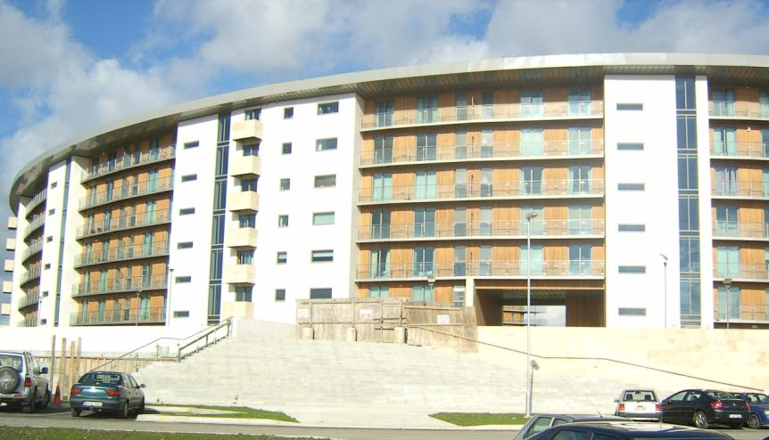
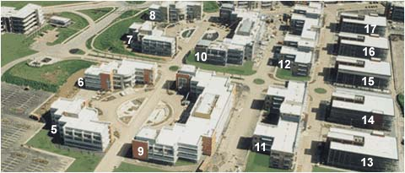
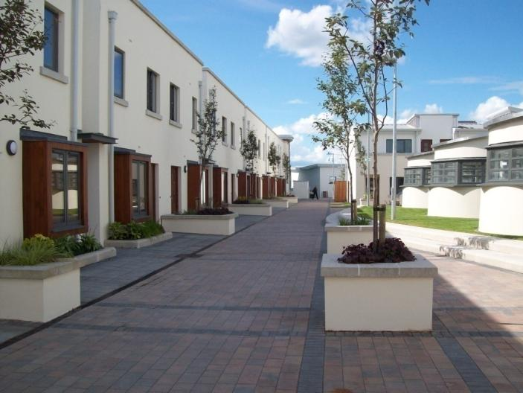
Suitable Projects for Siphonic Drainage
Apartment Blocks
Podium Decks
Notes:
Apartment blocks can benefit from using siphonic drainage because you can route the downpipes to service cores
Podium decks can benefit where there is sufficient vertical displacement from podium deck to the termination point

Slide 35
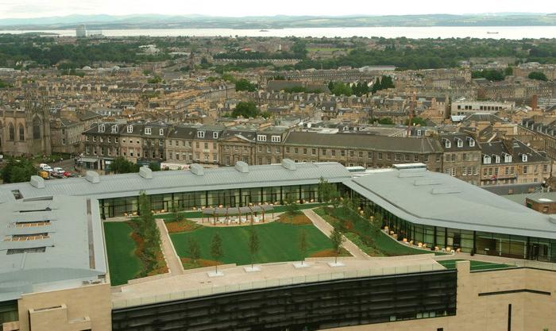
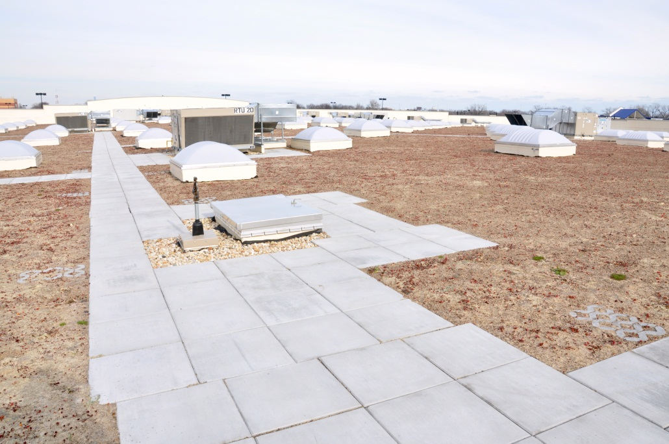
Green Roofs
Suitable Projects for Siphonic Drainage
Wal-Mart Chatham, IL
Notes:
This is the award winning Scottish Parliament building. The Terrain-Mifab HydroMax™ system was selected because of the technical ability to drain complex roofs through unobtrusive small diameter pipes.

Slide 36
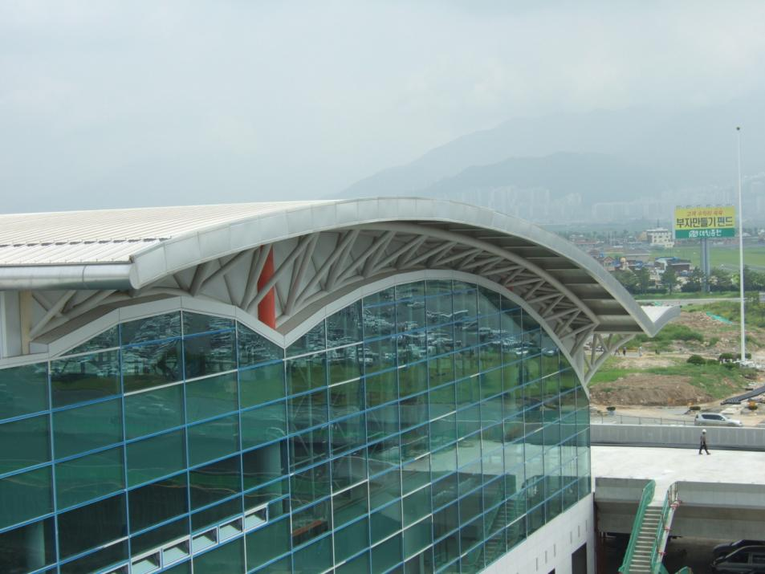
Suitable Projects for Siphonic Drainage
Airports
Gimhae South Korea
Notes:
We have used Siphonic Roof Drainage systems for small domestic airports and large international airports.

Slide 37
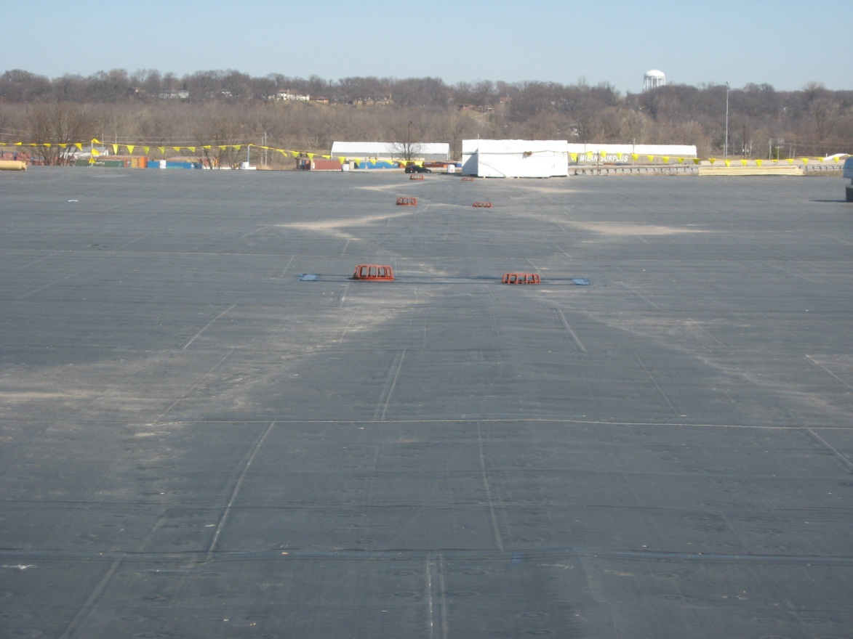
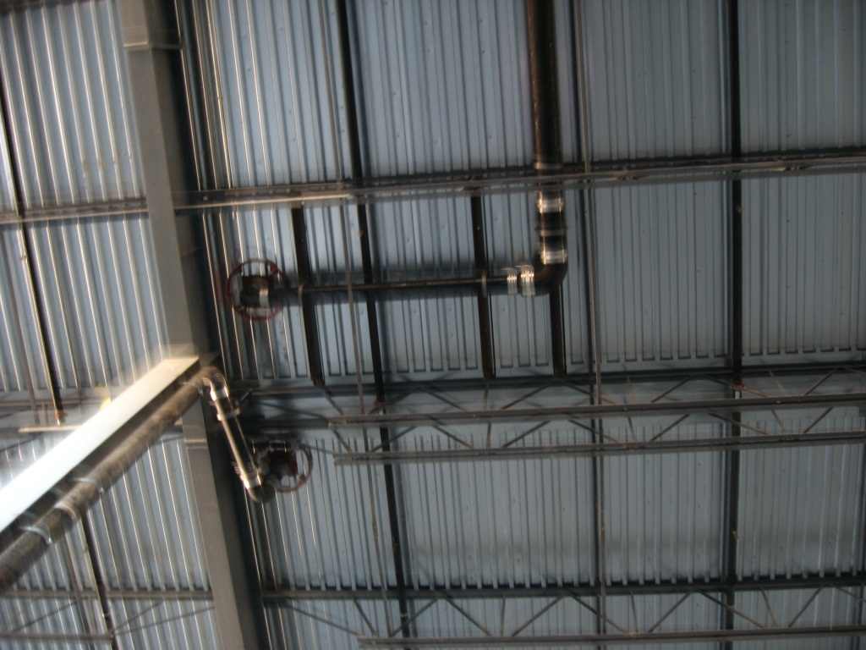
Suitable Projects for Siphonic Drainage
Manufacturing Plants/Warehousing
John Deere, Milan, IL
Notes:
Our Siphonic Roof Drainage system’s have been used on numerous hi-tech electronics and Pharmaceutical projects.

Slide 38
Flagship Projects
Suitable Projects for Siphonic Drainage
Scottish Parliament
Notes:
This is the award winning Scottish Parliament building. The Terrain-Mifab HydroMax™ system was selected because of the technical ability to drain complex roofs through unobtrusive small diameter pipes.

Slide 39
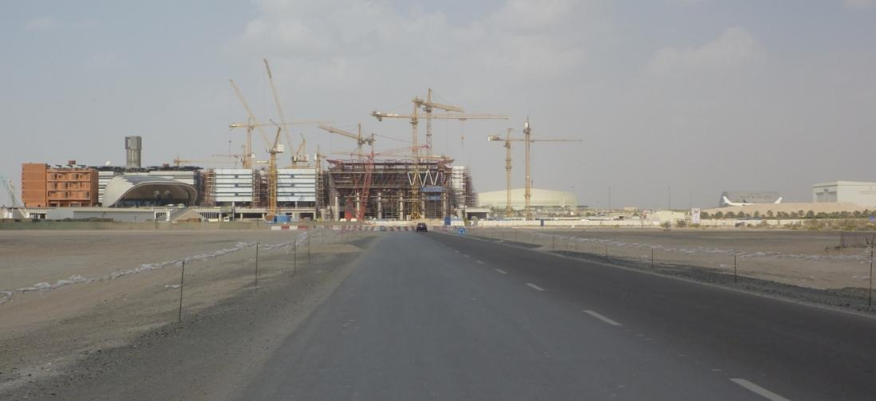
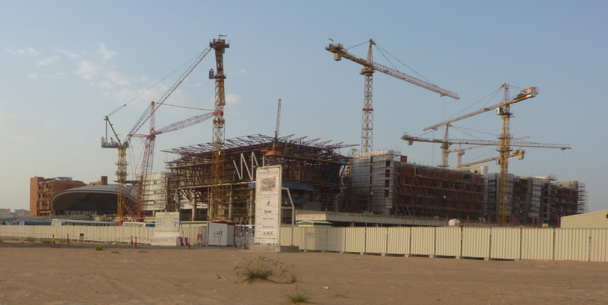
Flagship Projects
Suitable Projects for Siphonic Drainage
Masdar City (MIT) Mass. Institute of Science and Technology, Abu Dhabi
Notes:
This is the award winning Scottish Parliament building. The Terrain-Mifab HydroMax™ system was selected because of the technical ability to drain complex roofs through unobtrusive small diameter pipes.

Slide 40
Mifab HydroMax™ Siphonic System
Mifab HydroMax™ Collector Pipe at High Level
Notes:
Here is the internal shot.
Several roof drains connect into the high level horizontal carrier pipe. The pipe runs unobtrusively at high level.
If this was a traditional gravity scheme, there would be rainwater pipes on every column which would interfere with the loading docks and the door mechanisms where the pipes would have to offset to pass over the pad foundation.
In addition to saving money on the project Terrain Mifab HydroMax™ provides a huge benefit technically and maximises the space available.

Slide 41
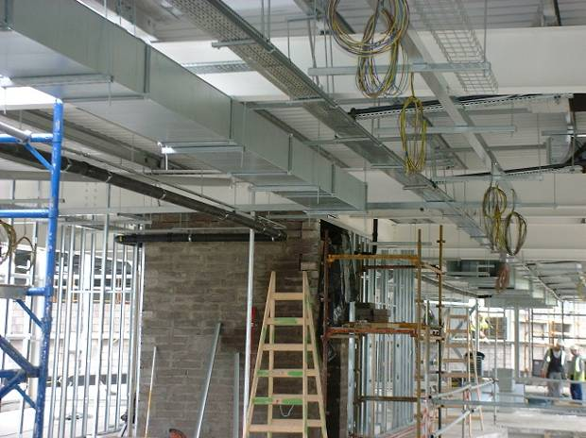
Mifab HydroMax™ Siphonic System
Level, Small Diameter, Pipes Makes for Easy Co-ordination with structure and services
Notes:
This is an example of how easy it is to co-ordinate the pipework in congested ceiling voids.

Slide 42
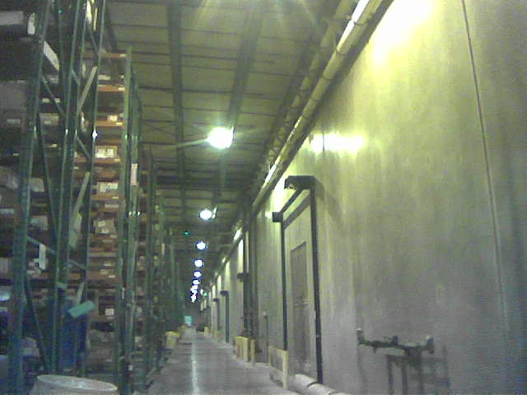
Mifab HydroMax™ Siphonic System
Mifab HydroMax™ Pipework Installed Absolutely Flat Level Runs to Corner of Building
Target Distribution Center, CA
Notes:
The benefit is clear to see in this photograph with the pipework being able to run flat with small diameter pipes from one end of the car park to convenient downpipe location
This picture shows the pipes running below the beams but because the pipework runs absolutely level, the pipe can run through beams as we can hit the centre line of each beam

Slide 43
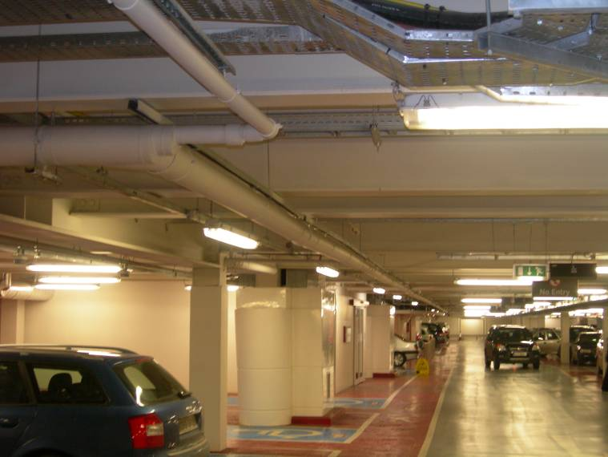
Mifab HydroMax™ Siphonic System
Top Level of Multi Level Parking Garage Mifab HydroMax™ Pipework Installed Absolutely Flat Level at High level
Notes:
The benefit is clear to see in this photograph with the pipework being able to run flat with small diameter pipes from one end of the car park to convenient downpipe location
This picture shows the pipes running below the beams but because the pipework runs absolutely level, the pipe can run through beams as we can hit the centre line of each beam

Slide 44
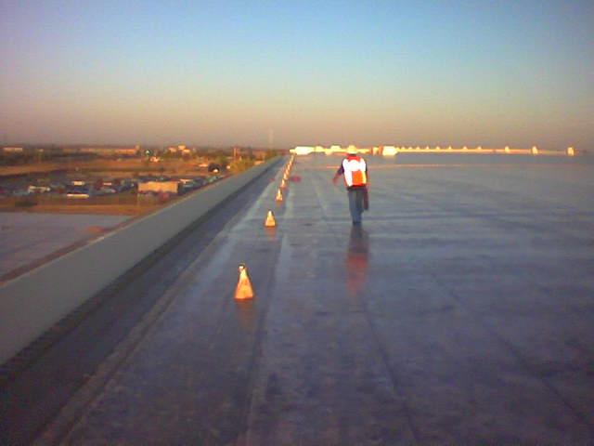
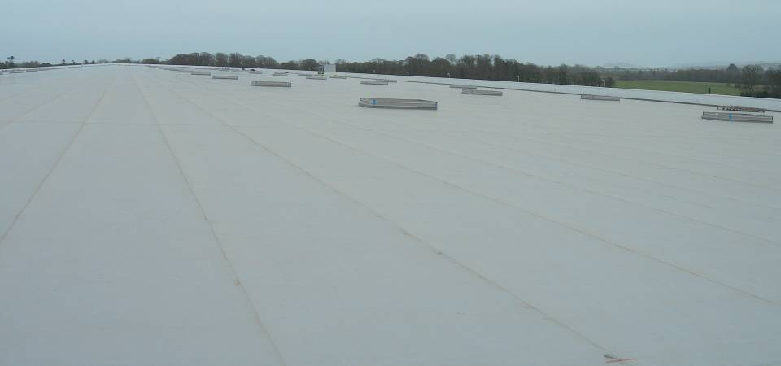
Understanding Savings
Warehousing & Distribution Centres
1,100,000 ft² Distribution Center Roof
Target Distribution Center, Shafter, CA
Notes:
Warehousing and distribution centres normally will use siphonic drainage systems due to the vast roof areas and associated technical and cost saving benefits

Slide 45
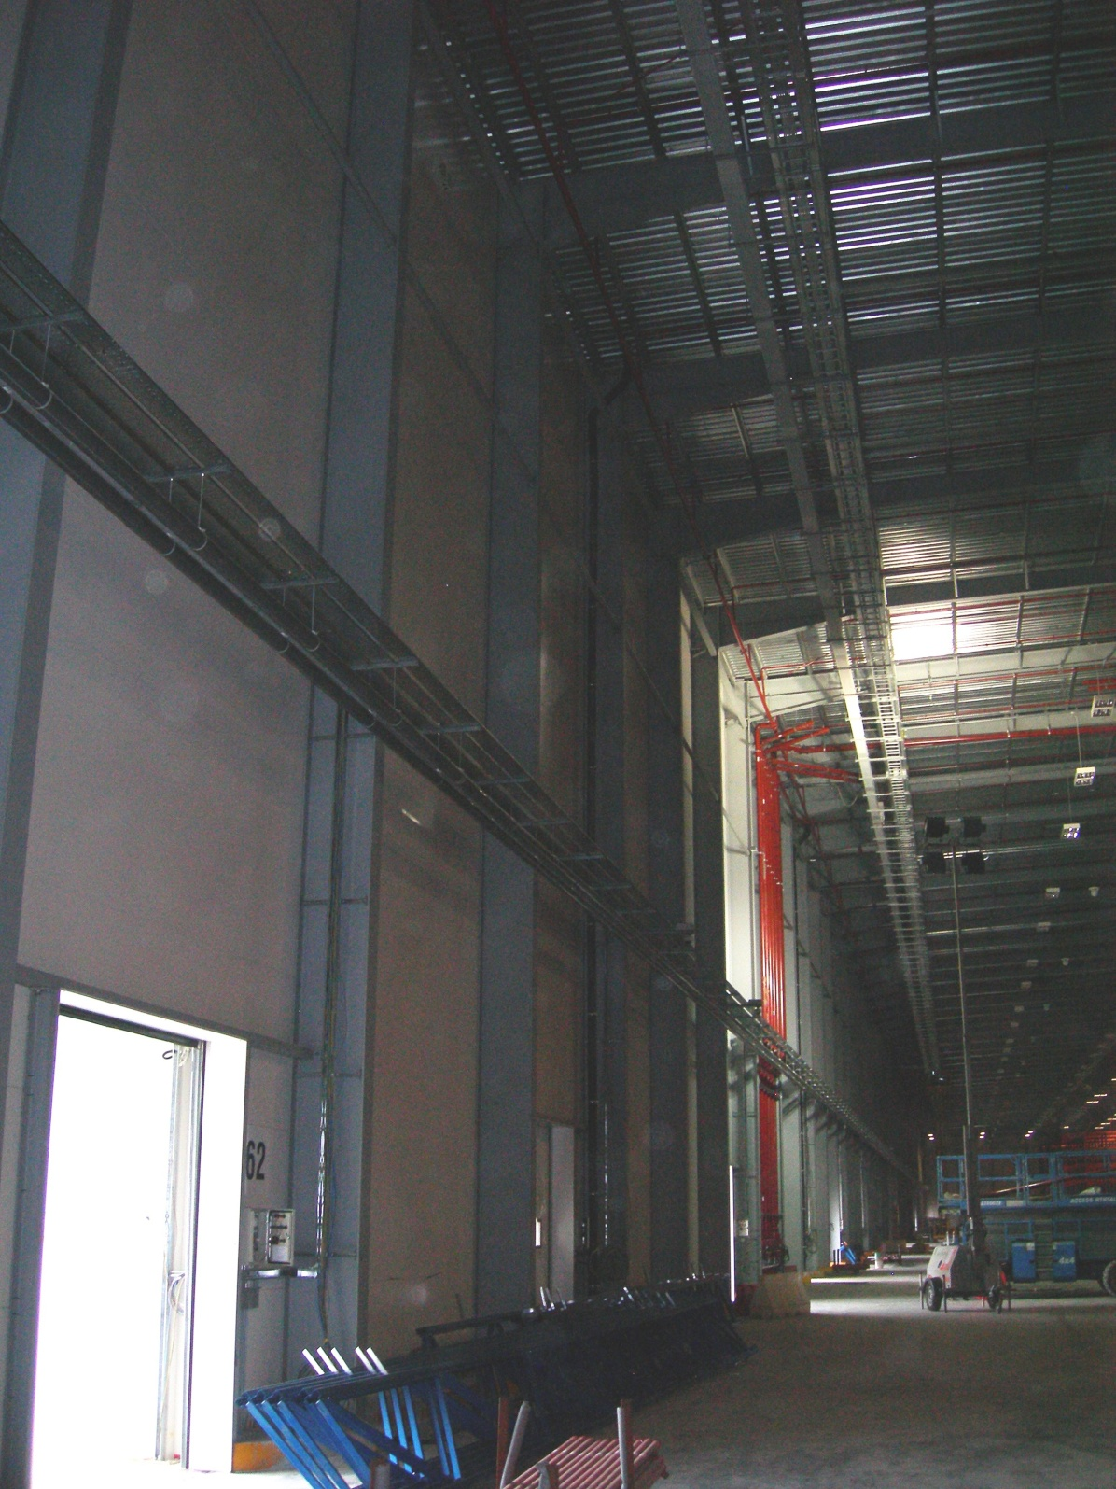
Original Gravity Option 144 x 6” Roof Drains
72no. 8” Downpipe (Every 45ft)
2,600 ft. of 8” Pipe
1,100,000 ft² Distribution Centre
HydroMax Solution
Only 36 x 5” Roof Drains
36no. 5” Downpipes (Every 90ft)
1300 ft. of 5” Pipe
SAVINGS
108 x 6” Roof Drains & penetrations
36no. Downpipes & MH connections
1300 ft. of Pipe and reduced diameter
60% the labour cost
Notes:
This is a large cargo centre for British Airways.
Unfortunately we cannot get a good photograph because the main runway of London’s Heathrow airport is seen behind the building.

Slide 46
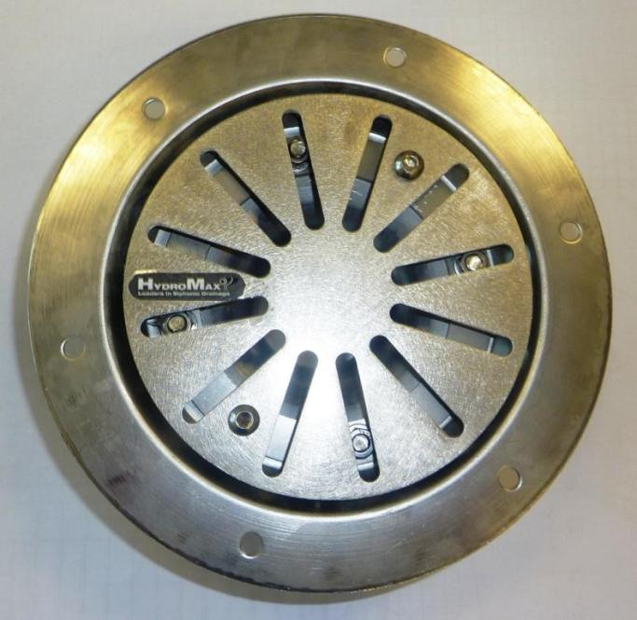
Mifab HydroMax Siphonic Products
2” Roof Terrace Siphonic Roof Drain
Flow Rate
Min. = 23 GPM
up to
Max. = 190 GPM
Notes:
Moving on to the systems component parts
The special design of the roof drain eliminates air ingress into the piping system which is empty before a storm event.
The fins that protrude from the inducer prevent vortex formation and routes the water directly into the pipe below.
As the water level on the roof or gutter reaches the flat inducer plate, air is effectively sealed off and cannot enter the pipe below.
The drains inflow is calculated by taking the roof drain catchment area and multiplying by the design rainfall rate (which will vary according to the project location and category of risk specified by the design team)
75mm drains can be used for inflows ranging from 1.5l/s up to a maximum of 25l/s.

Slide 47
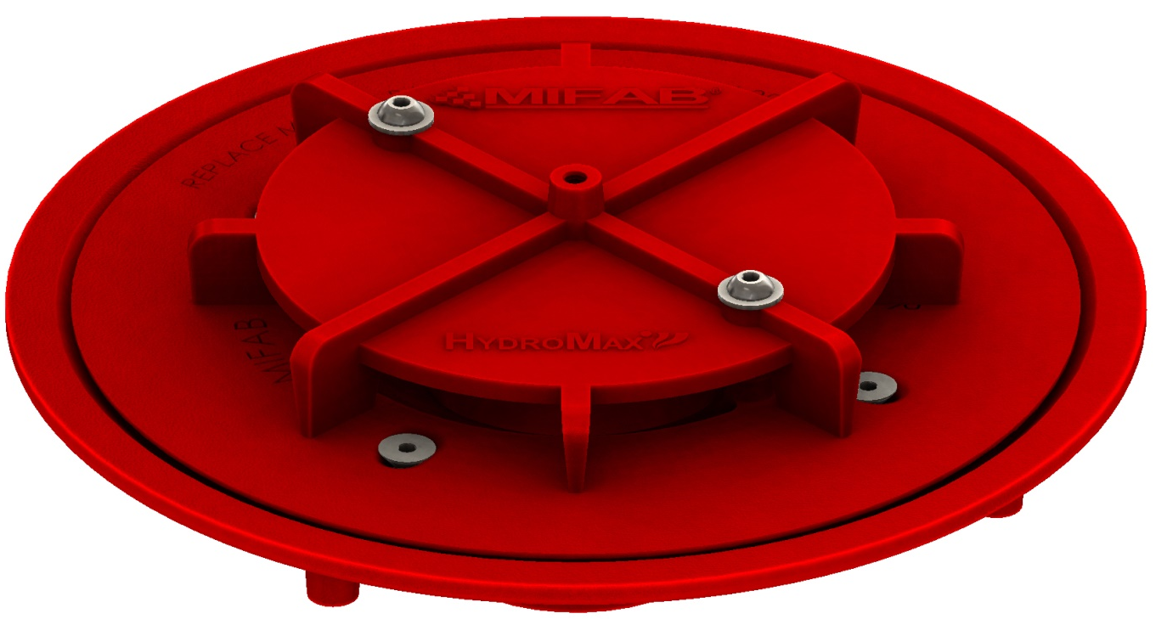
Mifab HydroMax Siphonic Products
3”, 4”, 5” and 6” Siphonic Roof Primary Drain Our drains have all been tested to ASME A112.6.9:2005
Low ‘K’ Factors = High Efficiency
& Low Ponding Depths
C.I. No-Hub Outlet | K factor | Minimum GPM Inflow | Maximum GPM Inflow
3” | 0.12 | 23 | 415
4” | 0.08 | 75 | 750
5” | 0.04 | 120 | 1300
6” | 0.04 | 160 | 1800
Notes:
Moving on to the systems component parts
The special design of the roof drain eliminates air ingress into the piping system which is empty before a storm event.
The fins that protrude from the inducer prevent vortex formation and routes the water directly into the pipe below.
As the water level on the roof or gutter reaches the flat inducer plate, air is effectively sealed off and cannot enter the pipe below.
The drains inflow is calculated by taking the roof drain catchment area and multiplying by the design rainfall rate (which will vary according to the project location and category of risk specified by the design team)
75mm drains can be used for inflows ranging from 1.5l/s up to a maximum of 25l/s.

Slide 48
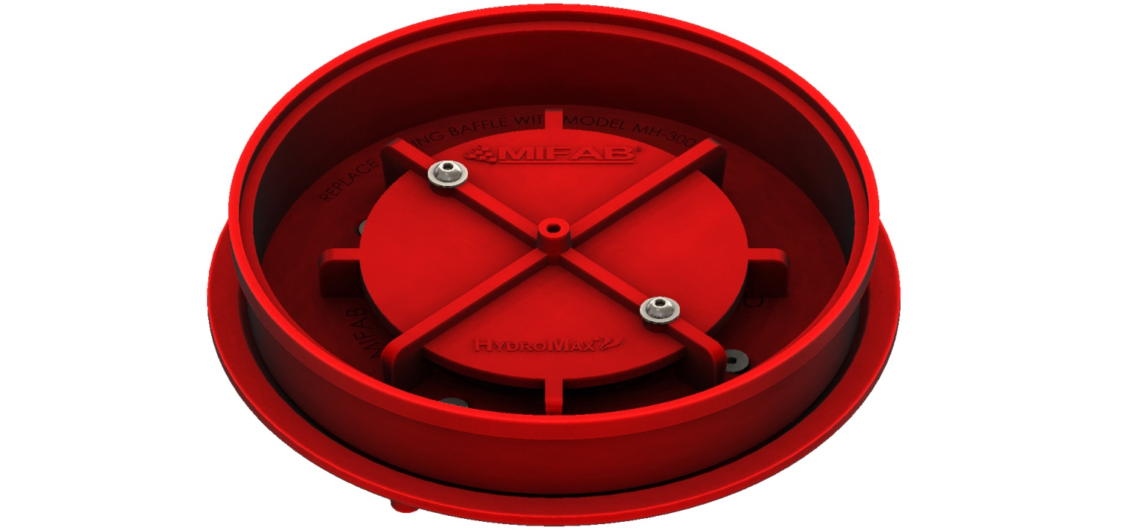
Mifab HydroMax Siphonic Products
3”, 4”, 5” and 6” Siphonic Roof Overflow Drain Our drains have all been tested to ASME A112.6.9:2005
Low ‘K’ Factors = High Efficiency
& Low Ponding Depths Comes with 2” Dam (you can add 1” increments to dam)
C.I. No-Hub Outlet | K factor | Minimum GPM Inflow | Maximum GPM Inflow
3” | 0.12 | 23 | 415
4” | 0.08 | 75 | 750
5” | 0.04 | 120 | 1300
6” | 0.04 | 160 | 1800
Notes:
Moving on to the systems component parts
The special design of the roof drain eliminates air ingress into the piping system which is empty before a storm event.
The fins that protrude from the inducer prevent vortex formation and routes the water directly into the pipe below.
As the water level on the roof or gutter reaches the flat inducer plate, air is effectively sealed off and cannot enter the pipe below.
The drains inflow is calculated by taking the roof drain catchment area and multiplying by the design rainfall rate (which will vary according to the project location and category of risk specified by the design team)
75mm drains can be used for inflows ranging from 1.5l/s up to a maximum of 25l/s.

Slide 49
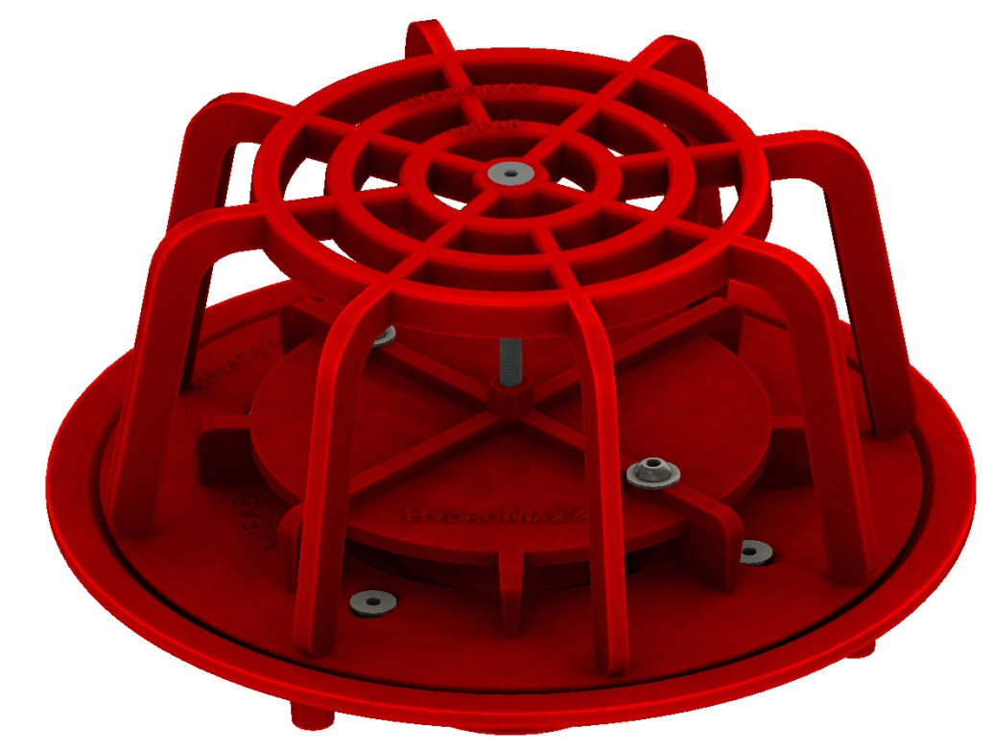
Mifab HydroMax Siphonic Products
3”, 4”, 5” and 6” Drain Accessories Leafguards, Debris Guards, Underdeck Clamps and Bearing Pans are available for all drains.
Drain shown with Debris Guard
Notes:
Moving on to the systems component parts
The special design of the roof drain eliminates air ingress into the piping system which is empty before a storm event.
The fins that protrude from the inducer prevent vortex formation and routes the water directly into the pipe below.
As the water level on the roof or gutter reaches the flat inducer plate, air is effectively sealed off and cannot enter the pipe below.
The drains inflow is calculated by taking the roof drain catchment area and multiplying by the design rainfall rate (which will vary according to the project location and category of risk specified by the design team)
75mm drains can be used for inflows ranging from 1.5l/s up to a maximum of 25l/s.

Slide 50
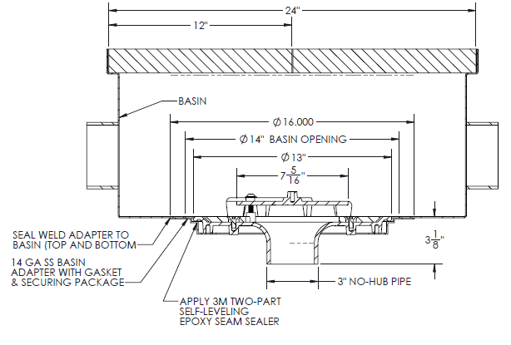
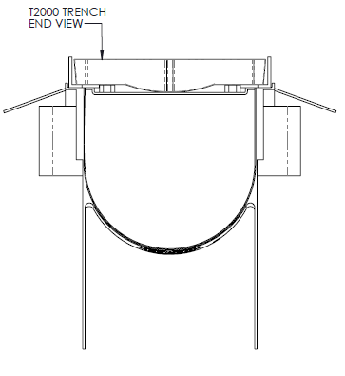
Siphonic Roof Drains can be combined with Trench Drains
Notes:
Moving on to the systems component parts
The special design of the roof drain eliminates air ingress into the piping system which is empty before a storm event.
The fins that protrude from the inducer prevent vortex formation and routes the water directly into the pipe below.
As the water level on the roof or gutter reaches the flat inducer plate, air is effectively sealed off and cannot enter the pipe below.
The drains inflow is calculated by taking the roof drain catchment area and multiplying by the design rainfall rate (which will vary according to the project location and category of risk specified by the design team)
75mm drains can be used for inflows ranging from 1.5l/s up to a maximum of 25l/s.

Slide 51
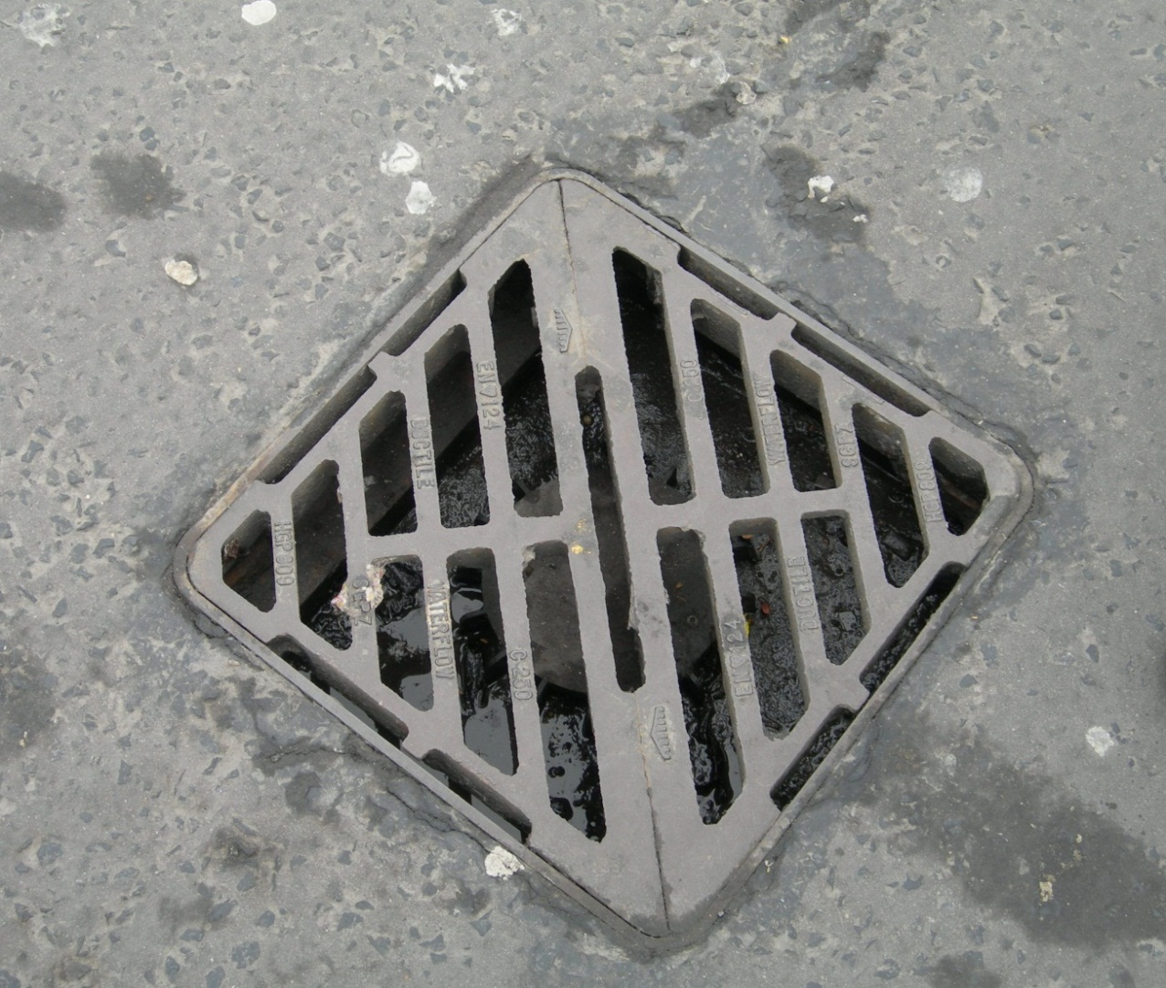
Siphonic Products
3” and 4” Drains are available as Podium Deck Drains
Using cast iron frame and grates to house the Siphonic Roof Drain
Notes:
Moving on to the systems component parts
The special design of the roof drain eliminates air ingress into the piping system which is empty before a storm event.
The fins that protrude from the inducer prevent vortex formation and routes the water directly into the pipe below.
As the water level on the roof or gutter reaches the flat inducer plate, air is effectively sealed off and cannot enter the pipe below.
The drains inflow is calculated by taking the roof drain catchment area and multiplying by the design rainfall rate (which will vary according to the project location and category of risk specified by the design team)
75mm drains can be used for inflows ranging from 1.5l/s up to a maximum of 25l/s.

Slide 52
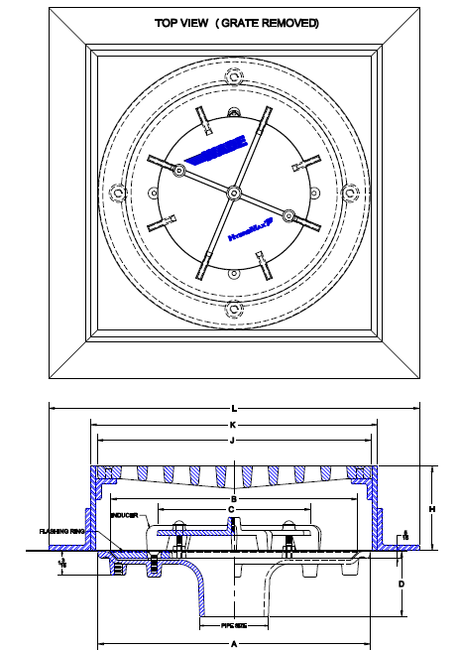
Siphonic Products
Drains are available as Parking Garage Drains
Using cast iron frame and grates to house the Siphonic Roof Drain
Notes:
Moving on to the systems component parts
The special design of the roof drain eliminates air ingress into the piping system which is empty before a storm event.
The fins that protrude from the inducer prevent vortex formation and routes the water directly into the pipe below.
As the water level on the roof or gutter reaches the flat inducer plate, air is effectively sealed off and cannot enter the pipe below.
The drains inflow is calculated by taking the roof drain catchment area and multiplying by the design rainfall rate (which will vary according to the project location and category of risk specified by the design team)
75mm drains can be used for inflows ranging from 1.5l/s up to a maximum of 25l/s.

Slide 53
Mifab HydroMax Siphonic Drain Benefits
High Performance
Best K factors of any drains = highest efficiency
Lowest ponding on the market
Versatile and Compatible with any Roof
Anti Tamper Fastening of one-piece Inducer
Proven track record of Low Maintenance (800 WalMart stores at June 2014)
Notes:
Siphonic drain benefits include
Significantly higher flow rates than gravity drains
They are manufactured in a range of materials to allow compatibility with all roof types
Compact for installation into gutters – Terrain Mifab HydroMax drains can be installed in gutters with only a 230mm wide sole
As the inducer/air baffle is critical to the operation of the siphonic system, you should specify that the drains be fitted with anti-tamper fastening of the inducer/air baffle

Slide 54
Siphonic Drainage Analytical Design Program
Mifab HydroTechnic
Analytical Design Software Program
Internet hosted software application
Always the most up-to-date version
Accessible from any computer / location
Allows Mifab HydroMax™ Design Assistance
Design calculations in Full Compliance with
ASPE Siphonic Drainage Design Standard ASPE/ANSI 45:2013
Accurate Calculations (in US Customary and SI Units as required for GSA projects)

Slide 55
Mifab HydroTechnic
Analytical Design Program
Design Choices Include a Variety of
Non-Proprietary Piping Systems
HDPE (this pipe system is the material of choice for most markets - it provides excellent design solution with huge range of diameters and exceptional performance with fully welded joint system)
Schedule 40 PVC (must be Solid Wall – No Foam Core)
No-Hub Cast Iron

Slide 56
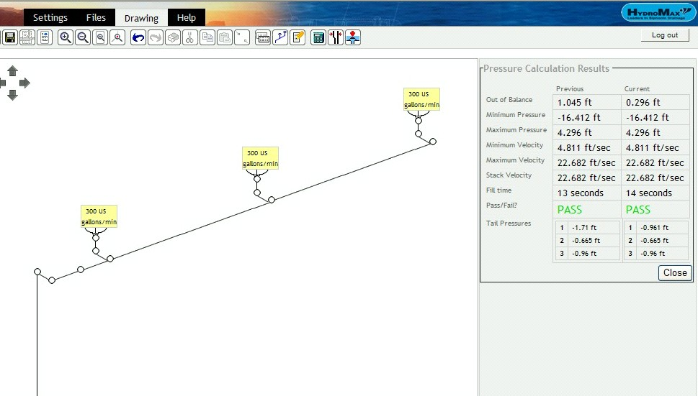
The Designer draws the required pipe routing into the program

Slide 57
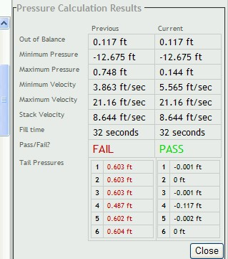
The Designer can then optimise the design for cost and performance benefits.
A Green “PASS” means the solution is in full accordance with ASPE/ANSI 45:2013

Slide 58
Mifab HydroTechnic
Analytical Design Program
OVER 8,000 Siphonic Roof Drain Projects
SUCCESSFULLY designed by HydroTechnic
100% SUCCESS RATE
ZERO System Design Failures
TRIED -
TESTED -
PROVEN

Slide 59
Mifab HydroTechnic
Analytical Design Program
We do not charge for the software
We do not charge for design support
We do not charge for online training
We do not charge for Contractor support

Slide 60
Pipe Supports
Pipe Brackets should be installed at each side of each change of direction (bends and branches)
Supports shall be capable of supporting the pipe when full
(as you would for a gravity system)
Sway Bracing at 30 feet intervals

Slide 61
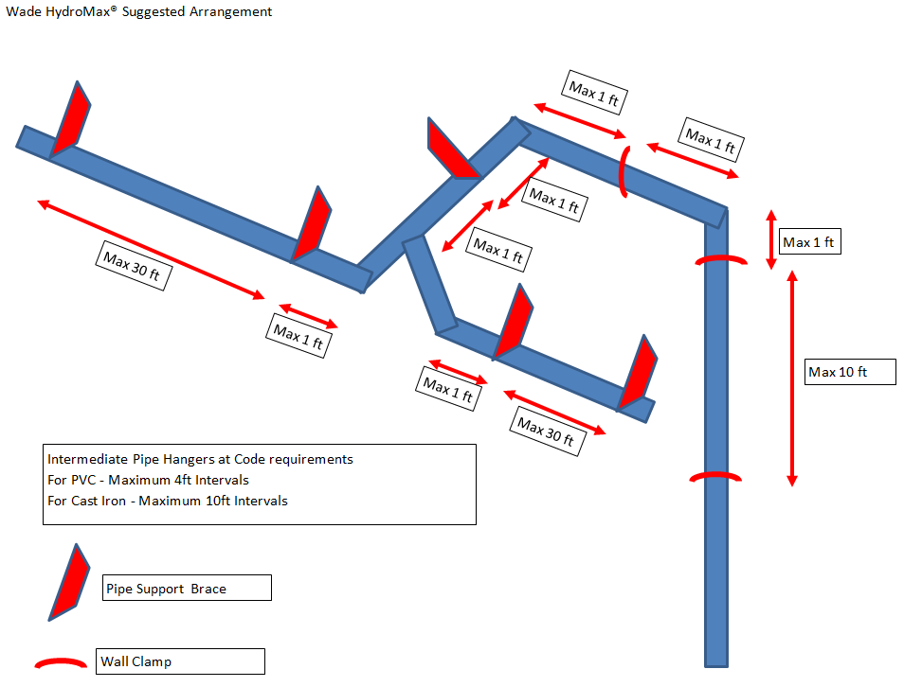
Bracket Supports and Bracing

Slide 62
HydroMax™ Termination Details (Siphon Break)

Slide 63
Key Advantages
High Performance, Self-Cleansing Roof Drainage System
Smaller diameter horizontal pipework installed level allows long horizontal runs
An Engineered Solution allowing choice of discharge locations
Improved Construction Build Program
Significant Cost Savings
Engineers Training and Support
Notes:
Finishing up we will summarise the key advantages to the various parties starting with the Building Owner
Siphonic drainage provides High Performance, Self-Cleansing Roof Drainage System
Elimination of underground drainage, manholes, etc. under the footprint of the building
Fewer Rainwater Downpipes are required and those that are required are routed to convenient positions providing an increased and flexible use of floor space

Slide 64
Key Advantages with Mifab HydroMax
Drains independently tested to ASME A112.6.9:2005
Designs in Full compliance with ASPE/ANSI 45:2013
Independently tested HydroTechnic design software (confirmed to have “unsurpassed accuracy”)
Range of High Performance Roof Drains (Outlets) with Market Leading performance
Designs with Suitable Pipes as listed in ASPE/ANSI 45:2013
Notes:
Seek drains which have passed independent testing to BS 8490:2007
And ASME 112.6.9:2005
As the whole operation is dependent on the hydraulic calculation seek independently tested design software which reports extreme hydraulic conditions and not averages
For sustainable supply with reduced transportation we provide UK manufacture of roof drains and UK manufactured pipes – no other company produces PE pipes to EN 1519 in the UK.

Slide 65
Information Requirements For Mifab HydroMax to Provide Concept Designs
Design Rainfall Rate
Roof Plan Drawings (AutoCAD)
Floor Plan Drawings (AutoCAD)
Sections/Elevation Drawings (AutoCAD)
Underground drainage Connections
Attenuation or Rainwater Harvesting Requirements
Is the below grade being designed to free flow or surcharge
Specification (we can provide CSI or R10 type spec.)
Engineer’s details to set up User Account to access HydroTechnic™
Notes:
If you are looking for a concept design for your building the following information is required by the siphonic drainage designer
Design Rainfall Rate
Roof Plan Drawings (AutoCAD increase speed and accuracy)
Floor Plan Drawings (AutoCAD)
Sections/Elevation Drawings (AutoCAD) – as the vertical displacement is the energy to create the siphonic action these drawing are essential
Underground drainage Connections – this is sometimes chicken and egg – we can assist with the determination of locations required
Attenuation or Rainwater Harvesting Requirements
Gutter Profile (to allow compatibility checks)
Specification (we can provide R10 type spec.)

Slide 66
Why Use Mifab HydroMax?
Partnership with over 20 years EXPERIENCE
in Siphonic Roof Drainage Systems
TRACK RECORD OF
PROVEN SUCCESS
Warranty by Mifab Inc.

Slide 67
Why Mifab HydroMax®?
Technical Benefits
Code Compliance
Proven Technology with USA Track Record
Service & Support to Engineers and Contractors
Cost Savings (client, contractor???)
We have Tech. Support in Chicago, IL, with full-time in-house Design Consultant providing Engineer’s with all the assistance they require
Informative web-site

Slide 68
www.hydromax.com
Videos showing how it works and pine straw test
FAQ’s
Suitable Project Types
Technical Explanations
Technical Presentation
Registration accesses areas for further information and forums
Benefits (Design Team/Client/Contractor)

Slide 69
www.hydromax.com

Slide 70
www.hydromax.com

Slide 71
File Structure
Proto Design Firms – have Read/Write Permissions
Proto Design Firms – have Read/Write Permissions
Prototype Files
Site Adapt Firms – have Read Only Permissions
Site Adapt Firms – have Read Only Permissions
Site Adapt Firms – have Read Only Permissions

Slide 72
The World is Awakening to
a New Dawn in Drainage

Slide 73
Mifab-HydroMax® Siphonic Drainage Presentation
Written by
Bill Ross and Dr Malcolm Wearing BEng PhD CEng MICE MCIWEM

Slide 74
Mifab HydroMax™ Siphonic Drainage
Leaders in Siphonic Drainage
www.hydromax.com www.Mifab.com

